Slide 1
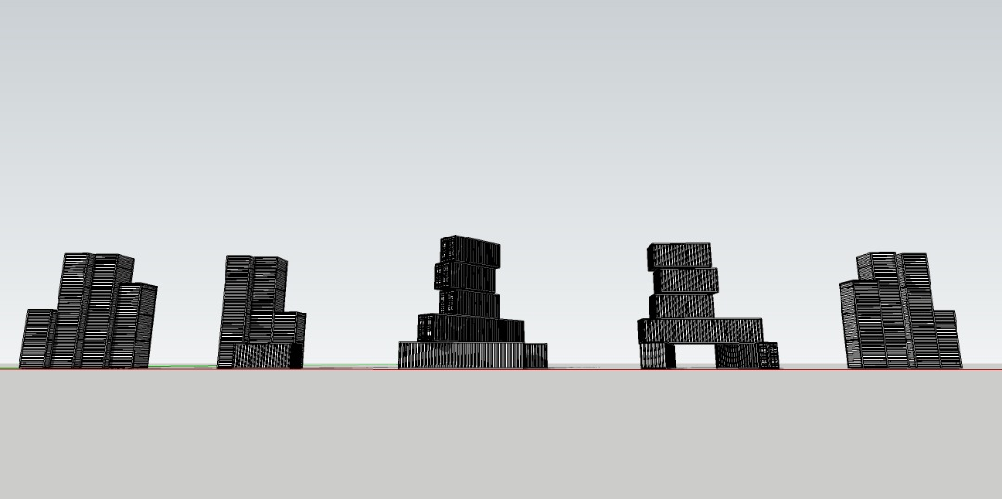



October 2019 to May 2020
***TO BE EXTENDED – Phase 1 (31 May to 31 December 2020)
Highlights:
5 Different Neighbourhoods in Penang
7 Local Experienced Muralists
5 Well-known International Muralists
30 Local Creative Talents in Urban Art
Organiser
Supported by

Slide 2
THE MURAL ART on INSTALLATIONS
“BACKLANE MURALS PROJECT”
Featuring 30 Local Artists
- MALAYSIAN URBAN ART TALENTS

Slide 3
THEME of ART
About PENANG
- Painting the Local Stories in Creative way
Based on research about the neighbourhoods of each Event Venue, infomation about the local identities including local people, history, art and culture will be provided to the artists
Based on interpretation and understanding about the respective neighbourhood, Artists are given freedom to paint a piece of work that creatively showcases the local identities or relevantly tells the local stories of Penang using his/her own creativity

Slide 4
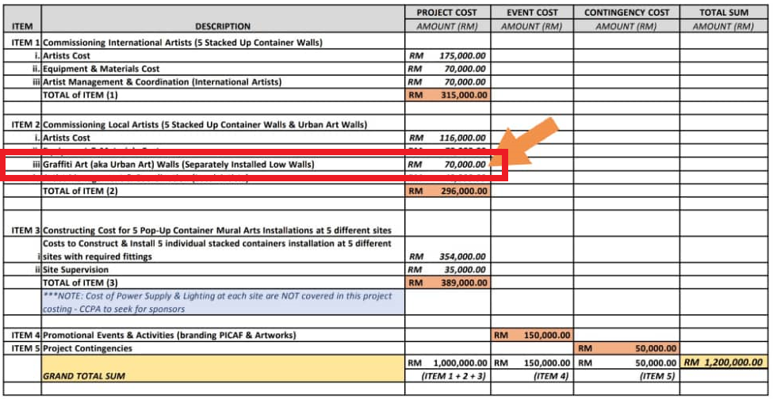
BUDGET ALLOCATION FROM PICAF
** An amount of RM70,000 from the RM1.2mil total budget was put aside for Backlane murals project.

Slide 5
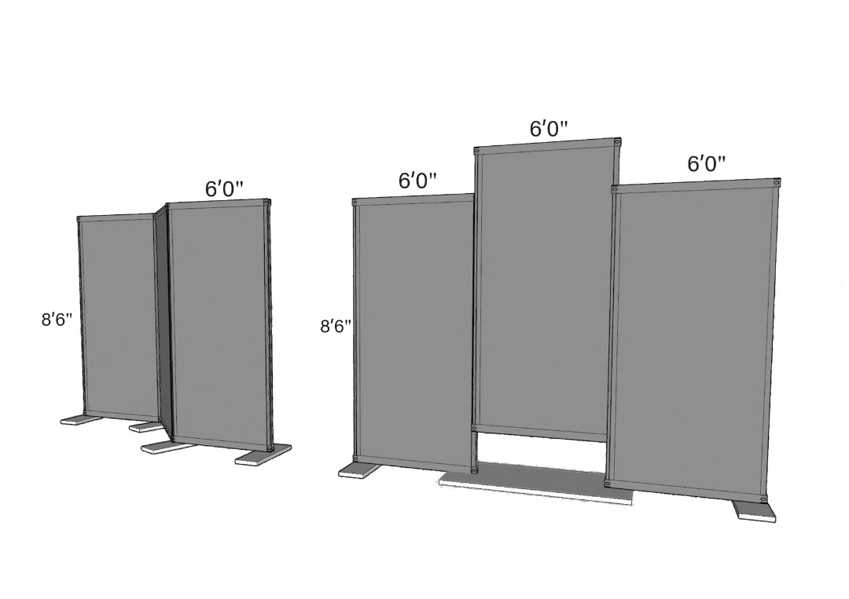
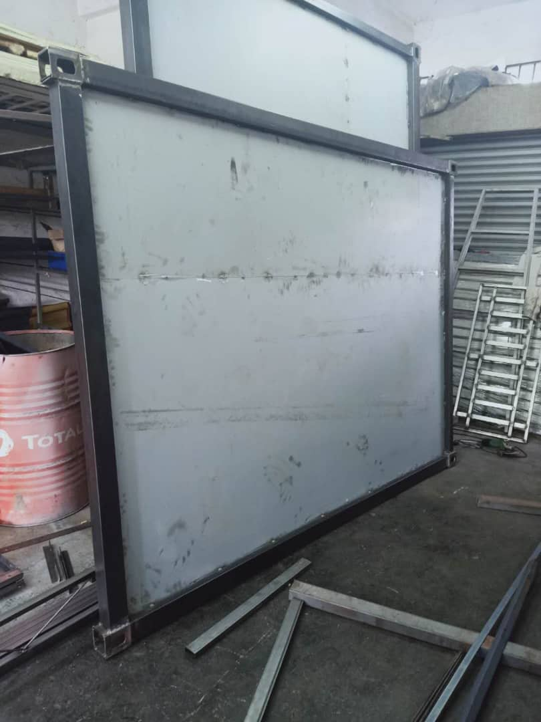
INSTALLATIONS ONSITE @ Backlanes
Proposed 3 panels with 2 sides
6 artists for each side
All metal panels be supported by mobilized concrete block as weight

Slide 6
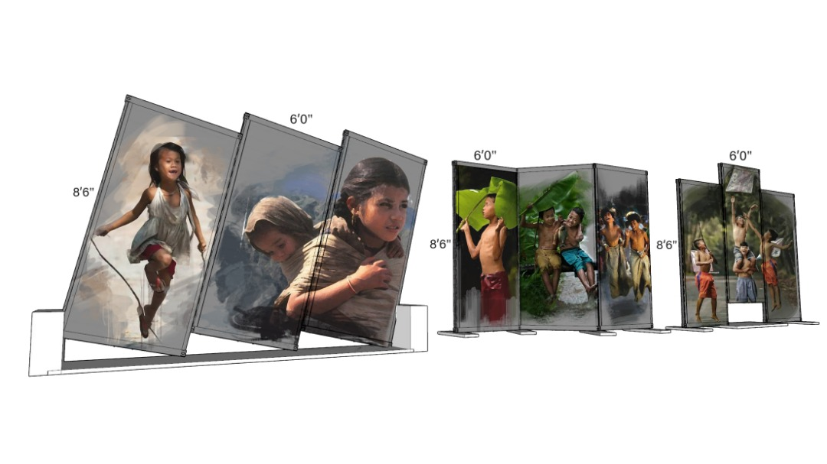
INSTALLATIONS ONSITE @ Backlanes – THE ARTIST’s IMPRESSIONS

Slide 7
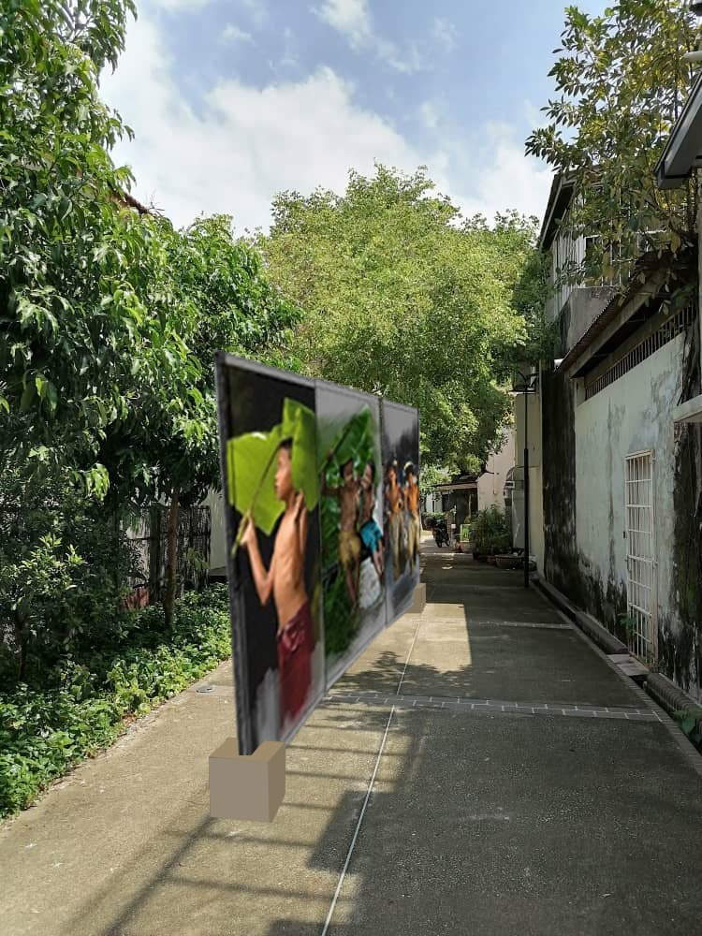
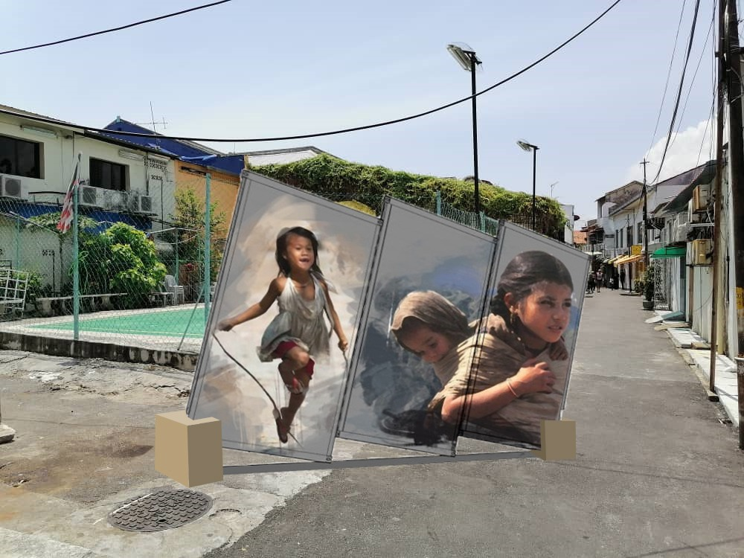
INSTALLATIONS ONSITE @ Backlanes – THE ARTIST’s IMPRESSIONS

Slide 8
BUDGET REQUIRED
FOR PICAF EXTENSION
With the extension period to 2022, an additional cost of RM185,500 would be needed. The detail of the revised budget for PICAF is as follow:

Slide 9
BUDGET REQUIRED – PHASE 1
Description | Prangin Mall | Karpal Singh Drive | Balik Pulau | Aspen Vision City | Dataran Pemuda Merdeka | Total
PHASE 1 (Till 31st Dec 2020)
1. Coordination and application process with MBSP | ── | ── | ── | RM 300 | RM 300 | RM 600
2. Coordination and application process with MBPP | RM 1,800 | RM 1,800 | RM 5,600* | ── | ── | RM 9,200
3. Maintenance of lighting, wiring & power supply | RM 1,000 | RM 1,000 | RM 3,500** | RM 1,000 | RM 1,000 | RM 7,500
4. Rewiring, repair and replace bulbs @ Balik Pulau | ── | ── | RM 3,800 | ── | ── | RM 3,800
5. CCPA Administrative & Management Fee | ── | ── | ── | ── | ── | RM 15,000
6. Public Liability Insurance Coverage Expenses | ── | ── | ── | ── | ── | RM 1,600
Total for Phase 1 |  |  |  |  |  | RM 37,700
The Budget Exclude Vandalism & Other Repair Cost if applicable during the Phase 1 extension period. *Covers resubmission fee paid to MBPP for adjustment of earlier approved plan of Ernest’s installation (which was then replaced with the current installation) **Monthly electric bill and token for home owner at Balik Pulau.

Slide 10
BUDGET REQUIRED – PHASE 2
Description | Prangin Mall | Karpal Singh Drive | Balik Pulau | Aspen Vision City | DPM | Total
Phase 2 (1st Jan 2021 to 31st Dec 2021)
1. Maintenance of lighting, wiring, power supply & etc. | RM 3,000 | RM 3,000 | RM 9,600* | RM 3,000 | RM 3,000 | RM 21,600
2. Maintenance of container installation at site & Site conditions | RM 2,400 | RM 2,400 | RM 2,400 | RM 2,400 | RM 2,400 | RM 12,000
3. Public Liability Insurance Coverage Expenses | ── | ── | ── | ── | ── | RM 3,200
4. CCPA Administrative & Management Fee | RM 7,200 | RM 7,200 | RM 7,200 | RM 7,200 | RM 7,200 | RM 36,000
Sub Total |  |  |  |  |  | RM 72,800
5. **Contingency Budget | ── | ── | ── | ── | ── | RM 75,000
Total for Phase 2 |  |  |  |  |  | RM 147,800
GRAND TOTAL (Phase 1 & Phase 2) |  |  |  |  |  | RM185,500
All costs are budget for 12 months. *includes the Monthly Electric Bill and Token for home owner at Balik Pulau. **Contingency Budget to cover repair costs on damages due to vandalism & other unforeseen circumstances if applicable during the extension period. However, the budget excludes the cost for relocation and reinstallation to new site; the cost for construction of footing / foundation at new site; the expenses for supervision at site & etc. in the event of relocation & reinstallation is required during the extension period.

Slide 11
BUDGET REQUIRED – RELOCATION
Description | Prangin Mall | Karpal Singh Drive | Balik Pulau | Aspen Vision City | DPM | Total
Budget required for Relocation & Reinstallation of PICAF Container Artworks @ Batu Kawan
Professional Technical Consultation Fee Structural engineer and soil testing consultant, technical drawings, coordination with MBPP & MBSP | RM6,000 | RM6,000 | RM6,000 | RM6,000 | RM6,000 | RM30,000
Relocation/Transportation of Container Artwork to Batu Kawan | RM5,000 | RM5,000 | RM5,000 | RM5,000 | RM5,000 | RM25,000
Construction of Foundation/Footing | RM24,000 | RM20,000 | RM20,000 | RM20,000 | RM24,000 | RM108,000
Reinstallation of Container Artwork | RM15,000 | RM15,000 | RM15,000 | RM15,000 | RM15,000 | RM75,000
Management & Supervision | RM12,000 | RM12,000 | RM12,000 | RM12,000 | RM12,000 | RM60,000
Contingency & Others *Subject to change based on soil/ground condition, additional structural drawings, foundation **Eexcludes application cost of relevant license (if applicable) | RM20,000 | RM20,000 | RM20,000 | RM20,000 | RM20,000 | RM100,000
Total | 82,000 | 78,000 | 78,000 | 78,000 | 82,000
GRAND TOTAL (for all 5 installations) |  |  |  |  |  | RM398,000
Remark: The proposed costing excludes all power supply for electrical wiring and lighting connection needed at site

