Slide 1


Guides & Information Providing at various Entry Points

Slide 2

Objective
To enhance the entry points of Penang by providing guides and directions for a better journey planning by the traveler.
Highlighting the promotional campaign / promotional video at various entry points.
The entry points includes
  Penang Sentral
  Ferry Terminal (Pengkalan Sultan Abdul Halim – Butterworth terminal)
  KTM Butterworth Station
  Sungai Nibong Bus Terminal
  Penang Port Swettenham Pier

Slide 3
PENANG SENTRAL

Slide 4
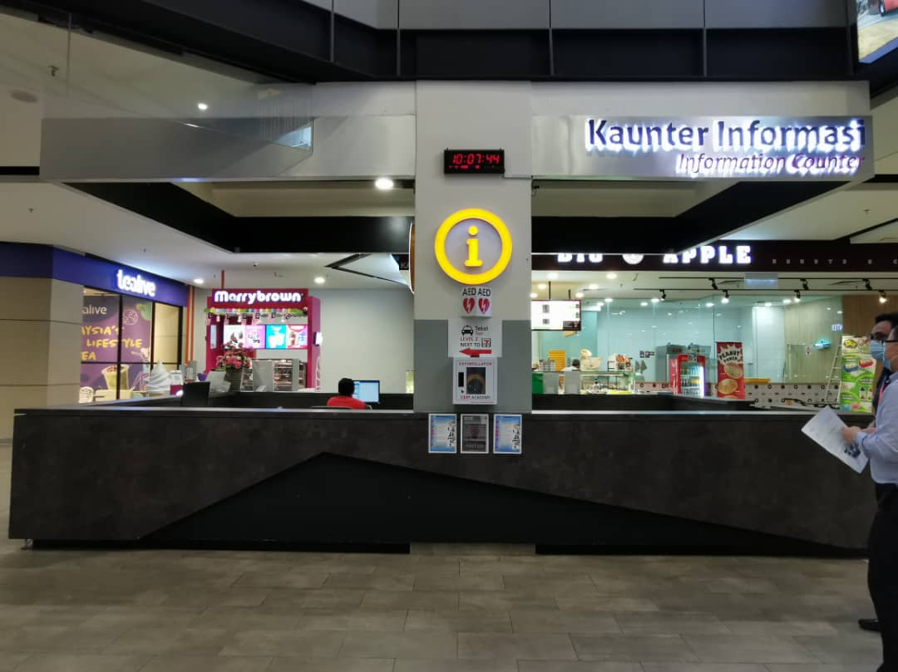

PENANG SENTRAL
6 ft (H)
3.5ft
6ft (W)
Place to put the brochure rack

Slide 5
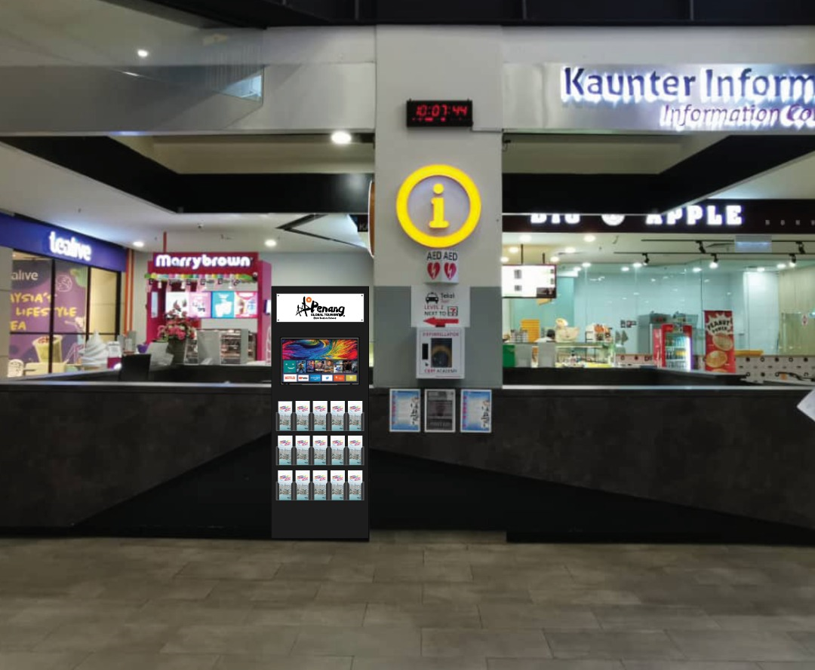
Superimposed design brochure rack for Penang Sentral
Superimposed design by ROD Creative

Slide 6
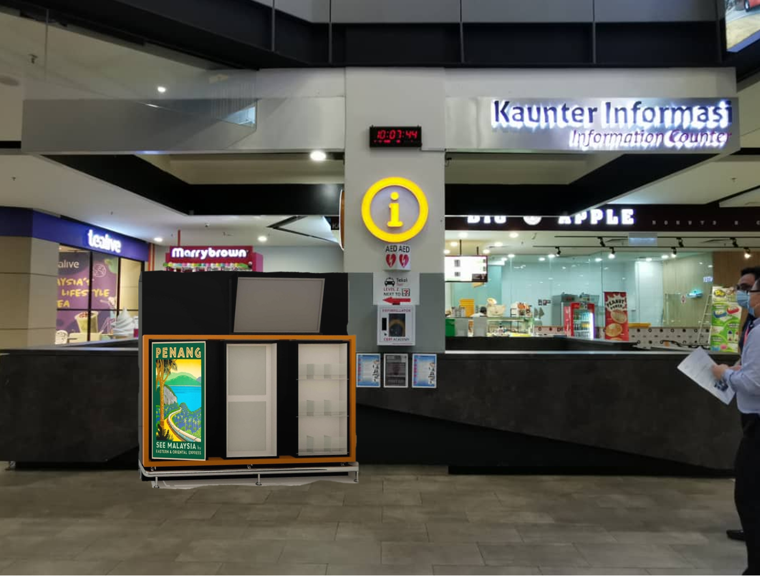
Superimposed design brochure rack for Penang Sentral
Superimposed design by DSOP Office

Slide 7
Ferry Terminal
(Pengkalan Sultan Abdul Halim – Butterworth terminal)

Slide 8
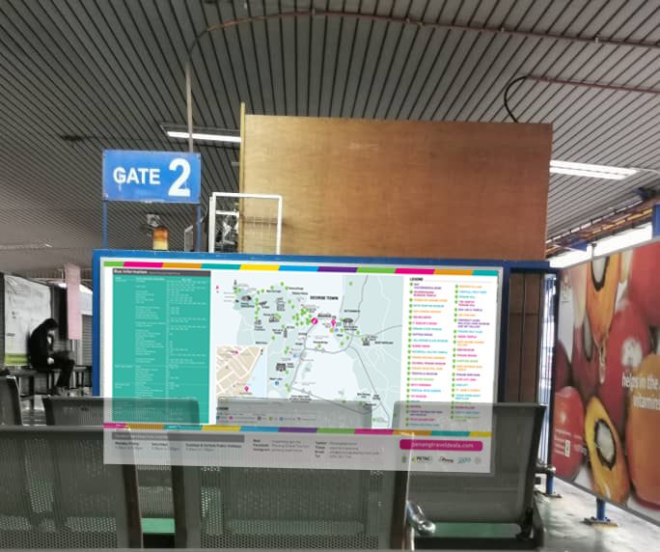
Superimposed for Design Panel 1

Slide 9
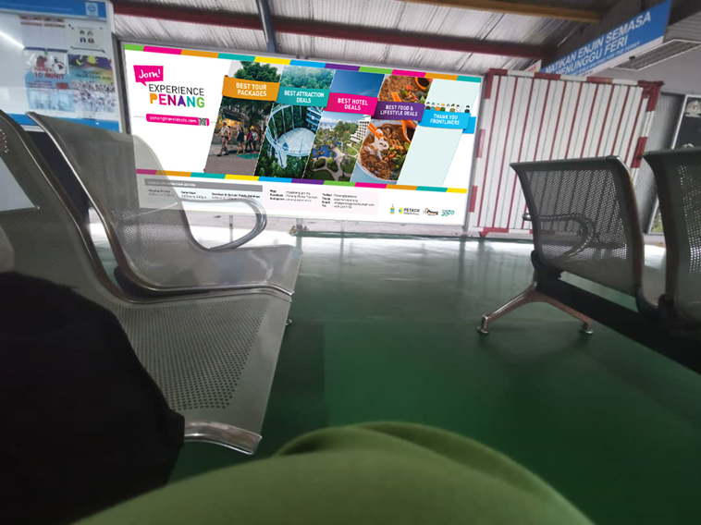
Superimposed Design Panel 2

Slide 10
KTM BUTTERWORTH

Slide 11
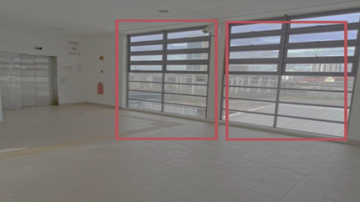
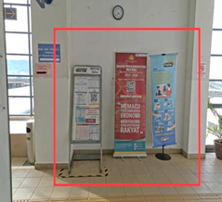
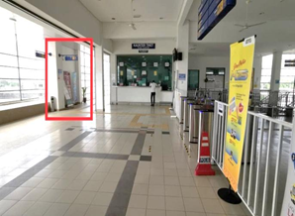
KTM BUTTERWORTH
Suggested place to put information rack

Slide 12
SUNGAI NIBONG

Slide 13
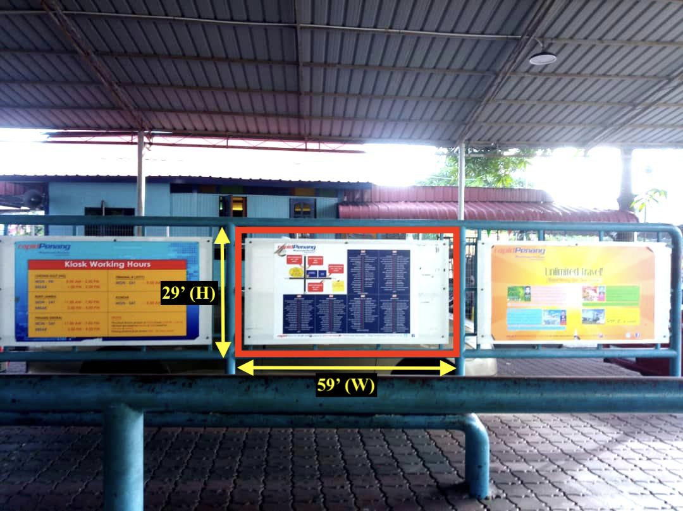
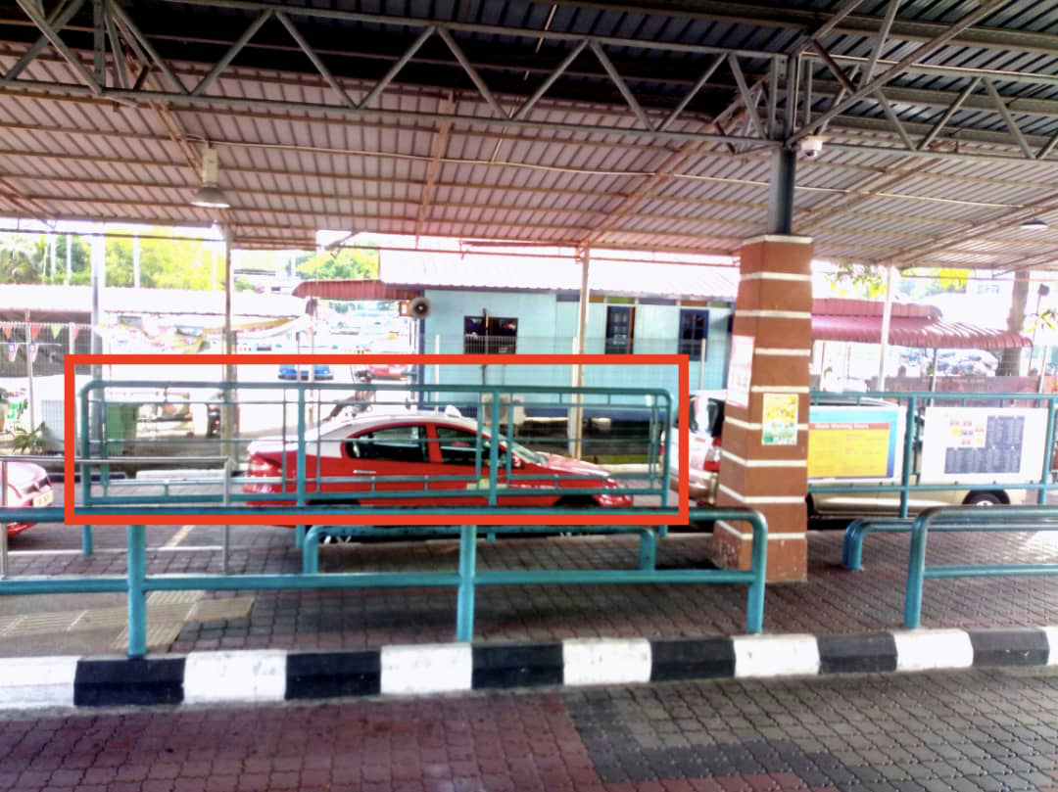
Sungai Nibong Bus Terminal
29’ (H)
52’ (W)
Size of panel : 52’(w) x 29’ (h)
3 empty panels to be utilized

Slide 14
SWETTENHAM PIER PENANG PORT

Slide 15
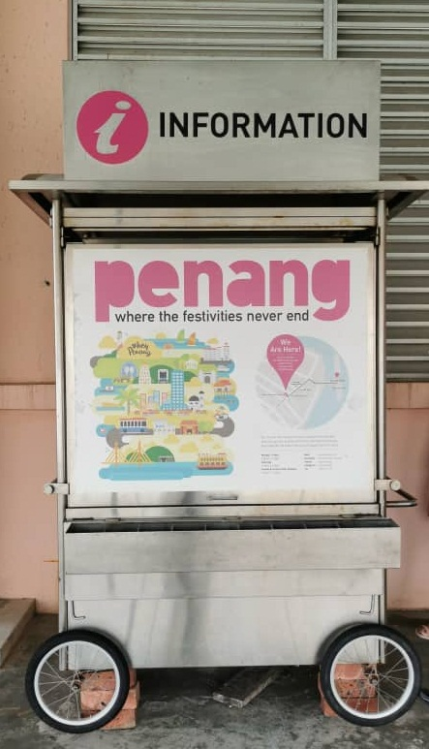
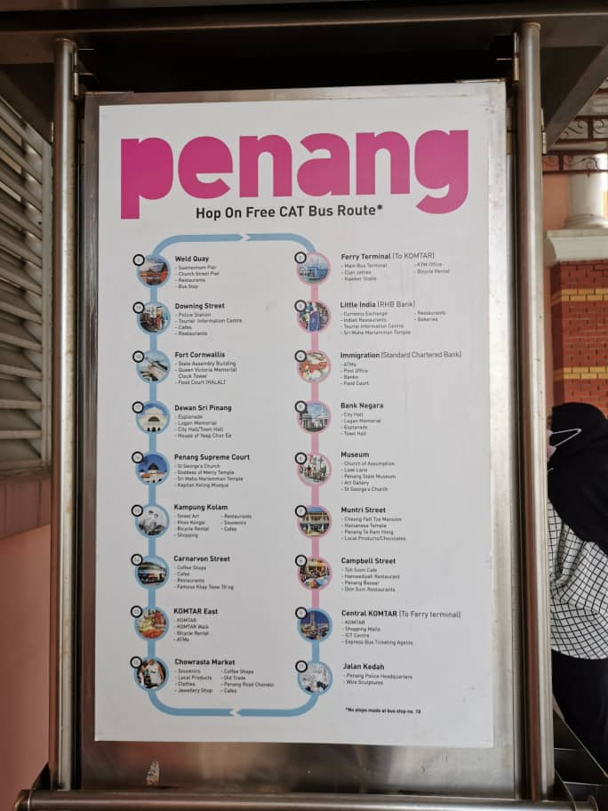
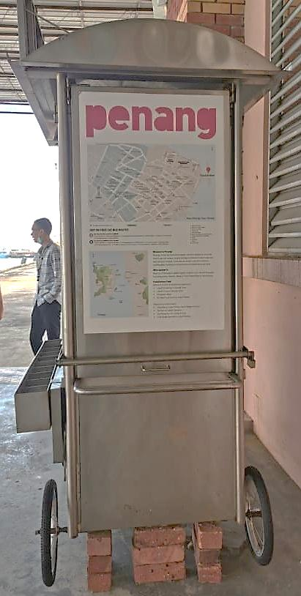
Information / brochure stall
Front image
Right side image
Left Side Image
The artwork (stickers on 4 sides), tires and body of stall will be changed to new ones.

