Slide 1
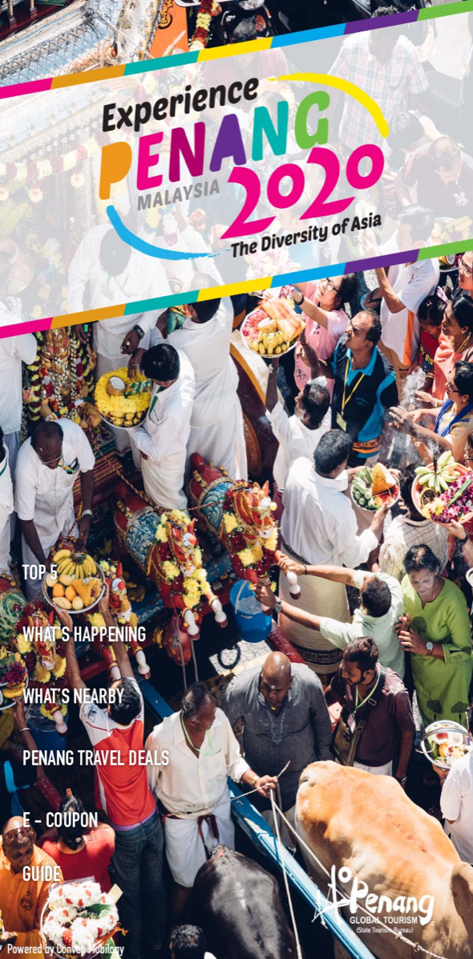
Remove Top 5 – Possible to save the content before removing? Also we will need to remove this chariot image.
This is the sample of layout
About Penang
Culture & Heritage
Food & Lifestyle
Nature & Adventure
What’s Nearby
What’s Happening
Penang Travel Deals
E-Coupon
Contact Us
Add:
About Penang
Culture & Heritage
Nature & Adventure
Food & Lifestyle
Swap the sequence of What’s Happening and What’s Nearby
Remove Guide and Replace with Contact Us (Info is on the website)

Slide 2

About Penang:
Before You Go
Accommodation
Penang Weather
Local Culture
Transportation
Download Brochures (Download & Share)
For this to follow information from the website: mypenang.gov.my
Remove:
Culture & Heritage
Food & Lifestyle
Nature & Adventure
Getting Around
Useful Contact Info

