Slide 1
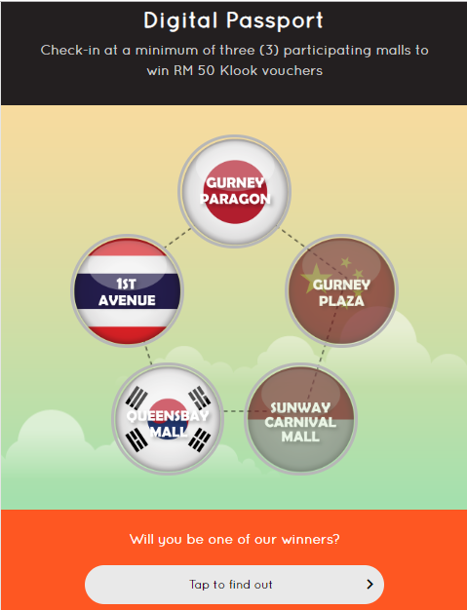
Change the copy to
Are you one of our winners?

Slide 2
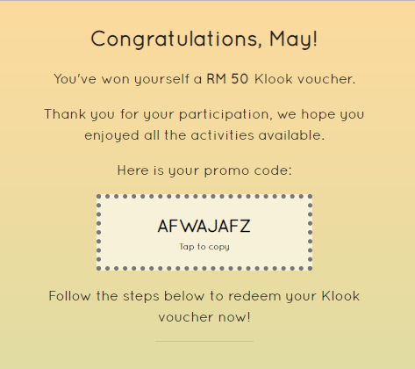
Change the copy to
You’ve won a RM 50 Klook Voucher
Change the copy to
Thank you for your participation, we hope you enjoy all the activities available.

