Slide 1
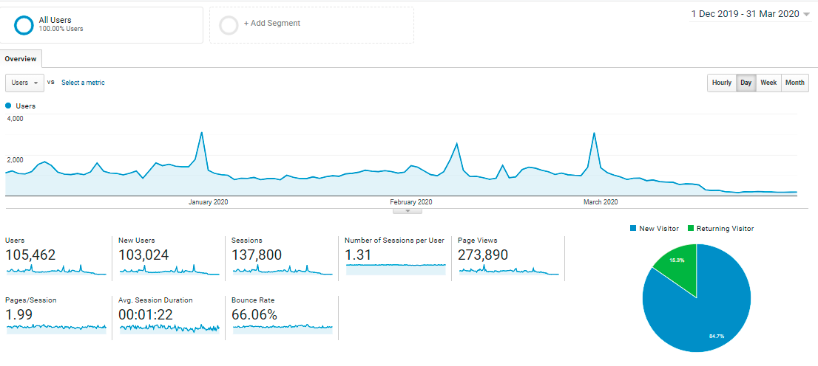
Tuesday, 31 December 2019
Users: 3,121
Most Viewed: Events
Saturday, 8 February 2020
Users: 2,544
Most Viewed: Thaipusam Story
Saturday, 29 February 2020
Users: 3,096
Most Viewed: Bukit Mertajam Story

Slide 2
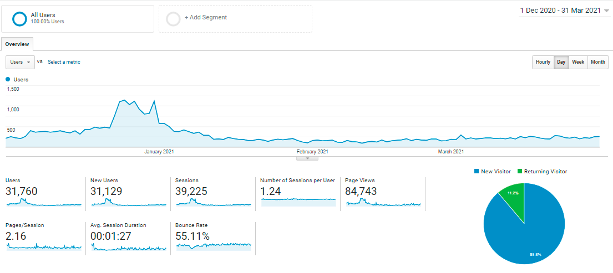
Sunday, 27 December 2020
Users: 1,115
Most Viewed: Homepage/ Events
Thursday, 31 December 2020
Users: 1,119
Most Viewed: Events
Friday, 25 December 2020
Users: 1,146
Most Viewed: Homepage/ Events

Slide 3
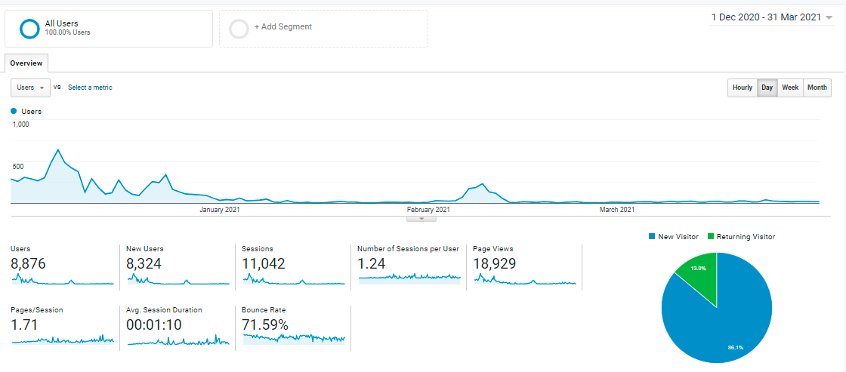
Tuesday, 8 December 2020
Users: 639
Most Viewed: Homepage/ Best Hotel Deals
Thursday, 24 December 2020
Users: 342
Most Viewed: Homepage/ Best Attraction Deals
Tuesday, 9 February 2021
Users: 234
Most Viewed: Best CNY & V Day Deals

