Slide 1
PSFF 2019
FESTIVAL PROPOSAL
BY TLM EVENT

Slide 2
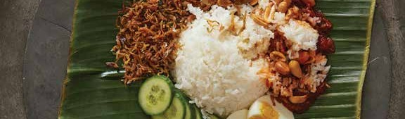
PSFF 2019
In this third consecutive year, the Penang Street Food Festival (PSFF 2019) are
captivate to bring back the same old nostalgic taste to everyone around the world. Penangites are lucky, owning the wealth of the most authentic street food, we come home to the best asam laksa while left home carrying the taste that are incomparable with no where else; making us a picky eater out of Penang, the eating culture in Penang are undoubtedly, one of a kind... In the Street Food Festival of 2019, we aimed in extending the norms, spreading the perks of street food in continuity while excavate the unexplored hidden gems and the hawker heroes while eventually made the Festival home to the street food, hawkers, and eaters... and there goes our theme of the year- EAT LIKE A LOCAL.
EXPERIENCE PENANG IN A BRAND NEW WAY!
Penang Street Food Festival Proposal 2019

Slide 3
CHAPTER 1
FESTIVAL OVERVIEW
Event:
Penang Street Food Festival
Date:
23 & 24 November
Time:
5pm - 11pm
Venue:
Beach Street, Penang
Target Crowd:
150,000
Objectives
1. To enhance the visibility of tourism in Penang.
2. To raise the growth of street food scenery in Penang.
3. To mushroom the culture of local eating in Penang.
4. Distinctive platform for the role players in street food to showcase their skills and product.
5. To promote Penang as a food paradise.
Penang Street Food Festival Proposal 2019

Slide 4
CHAPTER 2
VENUE
COORDINATION
Penang Street Food Festival Proposal 2019

Slide 5
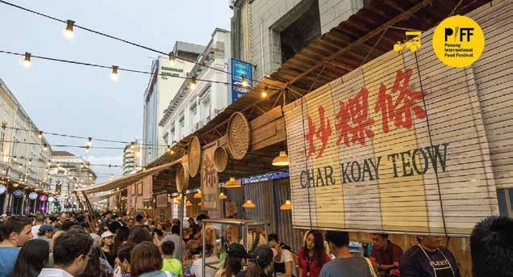





CHAPTER 3
FESTIVAL
HIGHLIGHTS
Largest Authentic Street
Food Festival
in
-
-
Penang
The largest authentic street
food festival in Penang
The best of Penang’s gastronomic offerings is
brought together
A total of 120 street food stalls, all in one station
-
Penang Street Food Festival Proposal 2019

Slide 6
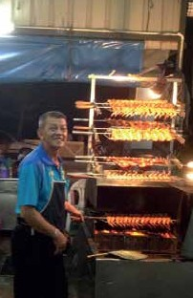
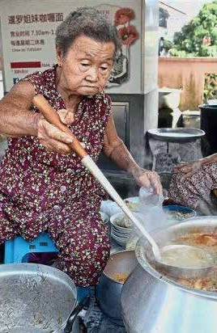
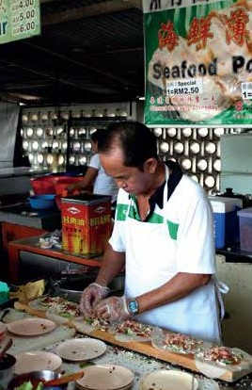
CHAPTER 3
FESTIVAL
HIGHLIGHTS
Hawker Heroes
-
-
Exploring hidden gems in Penang
Featuring hawker heroes in Penang’s food
landscape who are a hardworking breed dedicated to satisfying their diners
These culinary magicians will display their cooking prowess and deliver mouth-watering delicacies
-
page 1
Penang Street Food Festival Proposal 2019

Slide 7
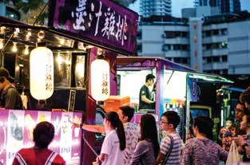
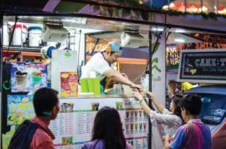
CHAPTER 3
FESTIVAL
HIGHLIGHTS
Food Truck Alley
-
Serving up best mobile street food on wheels, both
modern and traditional
A panoply of colourful food choices to tame the visitors’ growling tummy
A stellar entertainment line-up
-
-
Penang Street Food Festival Proposal 2019

Slide 8
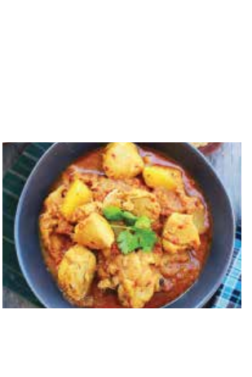
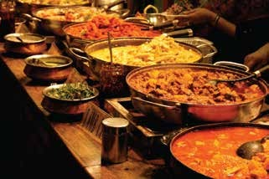

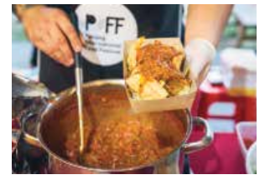
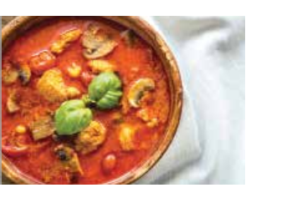
CHAPTER 3
FESTIVAL
HIGHLIGHTS
Curry Lane
-
-
A celebration of all things curry in one street
Catering to everyone on the spice scale
- from fans of the super spicy to the mucho mild
A jamboree of sensory experiences
-
•
•
•
•
•
Malay Curry
Indian Muslim Curry
Peranakan Curry
Japanese Curry
Vietnamese Curry
•
•
•
•
•
Indian Curry
Chinese Curry
Thai Curry
Nyonya Curry
Eurasian Curry
Penang Street Food Festival Proposal 2019

Slide 9
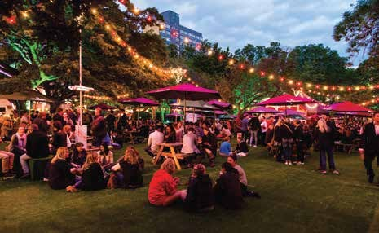
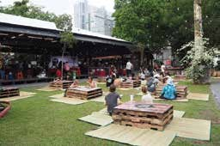
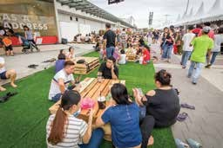
CHAPTER 3
FESTIVAL
HIGHLIGHTS
The Boulevard (Picnic
Area)
-
-
Dine amongst the skies of George Town
Relax and chill while tucking into a wide range of local cuisines
At one of Penang’s ubiquitous lanes
-
Penang Street Food Festival Proposal 2019

Slide 10
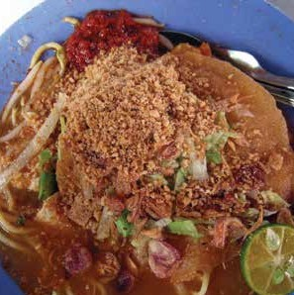
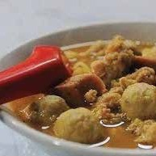
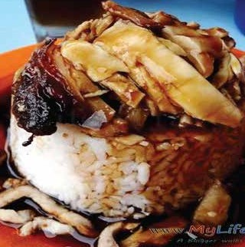
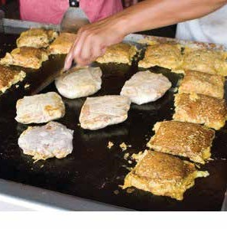
CHAPTER 4
FESTIVAL EATERIES
Mainland Delicacies
-
The well sought-after vendors from mainland
will crossover to island for two days
Uncovering the fascinating food landscape of mainland
Jumping fork into a wide variety of alluring mainland delicacies
-
-
Penang Street Food Festival Proposal 2019

Slide 11
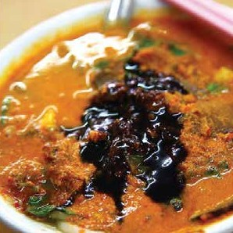
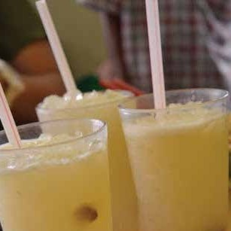
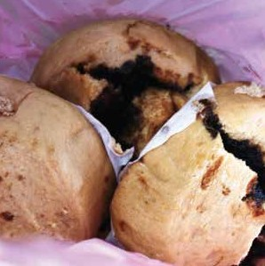
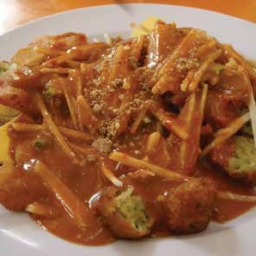
CHAPTER 4
FESTIVAL
EATERIES
Balik Pulau Eateries
-
-
Delicacies from the west of Penang
Visitors can ﬁnd well-known vendors from the rural
heartland of Balik Pulau
Balik Pulau Satay, Laksa Janggus, and Balik Pulau
Nutmeg Juice and Passion Fruit Juice
-
Penang Street Food Festival Proposal 2019

Slide 12
CHAPTER 4
FESTIVAL EATERIES
Participants
Non-halal
35
Muslim Friendly
35
Pop-up Stalls
10
Food Trucks
20
Highlighted
(Penang Street Food)
10
Highlighted
(Michelin Chef or Bib Gourmand)
3-5
Total
113-115
Penang Street Food Festival Proposal 2019

Slide 13

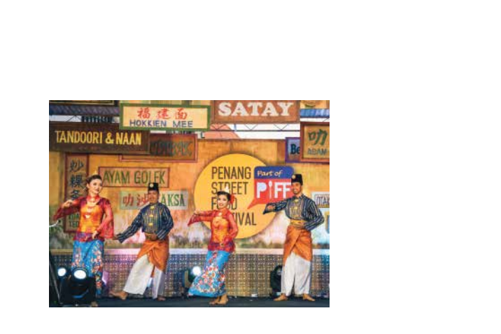
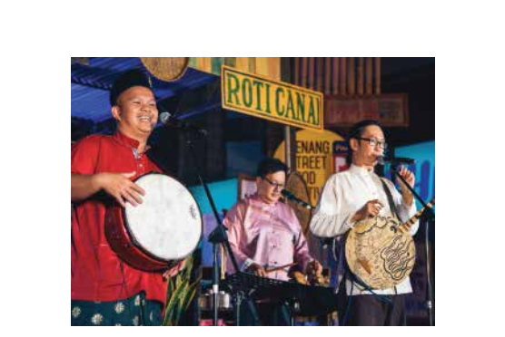
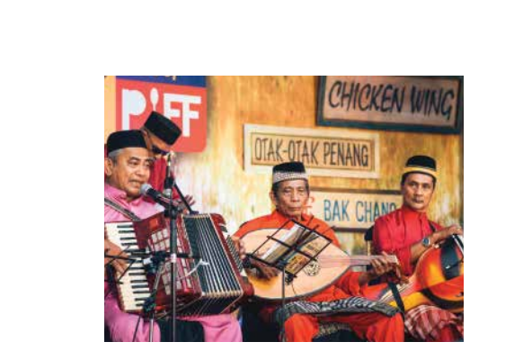
CHAPTER 5
PROGRAMME
Cultural Performances
-
Soundtracked by a medley of Chinese, Malay
and Indian cultural performances
A celebration of Malaysia's multiculturalism
Immersing in a smorgasbord of enticing treats served by the hawker heroes
-
-
Penang Street Food Festival Proposal 2019

Slide 14
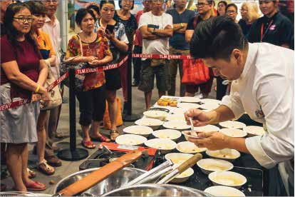
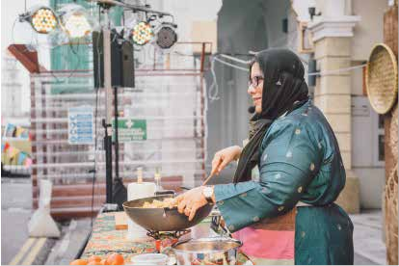
CHAPTER 5
PROGRAMME
Cooking Demo
-
The culinary magicians will showcase their
cooking prowess
These excellent chefs have honed their skills throughout the years to ensure only the best is available
-
Penang Street Food Festival Proposal 2019

Slide 15

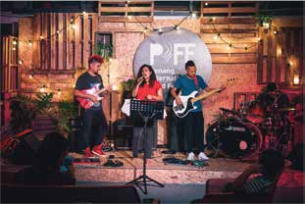
CHAPTER 5
PROGRAMME
Live Music Performances
-
-
Live music ﬁlling in the space
Chilling and keeping the visitors entertained during the festival
Penang Street Food Festival Proposal 2019

Slide 16

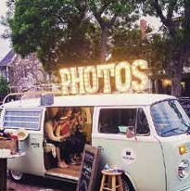

CHAPTER 6
PHOTOBOOTH
Retro Photo Booth
-
-
Retro photo booths will be set up at the festival
Visitors can take home wonderful Penang Street
Food Festival moments with them
Taking a break from the eating spree to capture some instagrammable shots
-
Penang Street Food Festival Proposal 2019

Slide 17
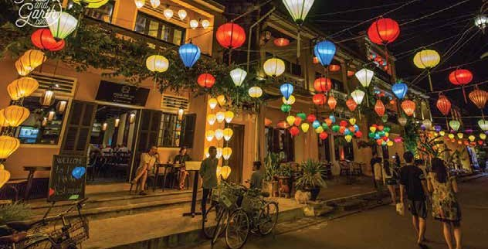
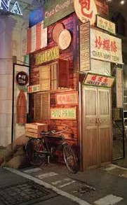
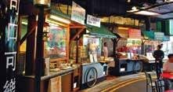
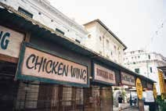
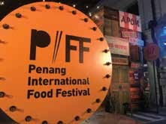
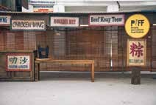
CHAPTER 7
DECO CONCEPT
Main Street
Street Lantern Installation | Old Penang
Penang Street Food Festival Proposal 2019

Slide 18


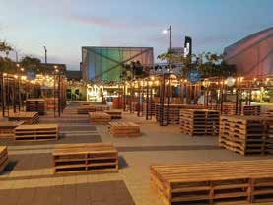
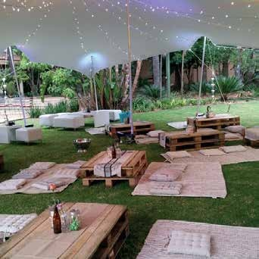
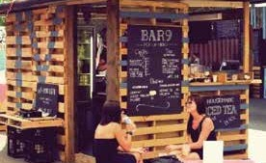
CHAPTER 7
DECO CONCEPT
Picnic Area
Wood Pallet | Fairy Lights
Penang Street Food Festival Proposal 2019

Slide 19
CHAPTER 8
PUBLICITY
Billboard
Streamer
Booklet
Leaﬂet
Radio
Social Media
Penang Street Food Festival Proposal 2019

Slide 20

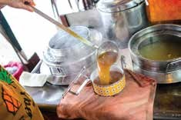
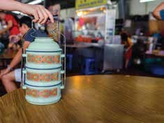
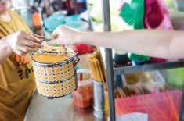
CHAPTER 9
FESTIVAL BRANDING
Bring Your Own Container Campaign
-
In line with the state government’s call to
promote green initiatives
Minimizing the usage of plastic and plastic straws
Visitors are urged to bring their own containers
or tifﬁns
-
-
Penang Street Food Festival Proposal 2019

Slide 21
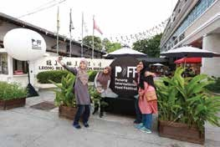
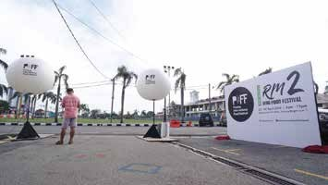
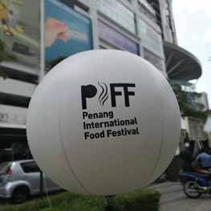
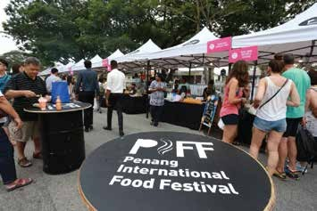
CHAPTER 9
FESTIVAL BRANDING
On Site Branding
-
Committed to building Penang Street Food Festival
as an iconic top-notch food festival in Penang When people think of food-related event, the Penang Street Food Festival comes ﬁrst to mind. On-site branding like backdrop and light ball will
build familiarity and positive experiences of visitors on the festival
-
-
Penang Street Food Festival Proposal 2019

Slide 22


PSFF X PENANG BRIDGE INTERNATIONAL MARATHON
Introduction
Penang, the 2nd biggest city in Malaysia is home to the popular Penang Bridge International Marathon (PBIM)
PBIM is the largest mass-participation sporting event in Penang, bringing tens of thousands of runners from local and international alike out onto the streets
every year
This year, Penang Street Food Festival will be brought out from Penang to a global stage, sharing the passion of the festival with the participants of PBIM
-
-
-
Penang Street Food Festival Proposal 2019

Slide 23
PSFF X PENANG BRIDGE INTERNATIONAL MARATHON
How it Works?
Arrangement of Shuttle Bus
(Beach Street to and fro Queensbay Mall)
-
-
-
Specially arranged for runners joining the 10-km fun run
Available from 7pm to 12am on 23rd July 2019
Runners will get to sink their teeth into a smorgasbord
of local street food, experiencing the incredible offerings
of Penang
PSFF Merchandise Giving
-
Giving away the exclusive merchandise of the festival to
the ﬁrst 1,000 runners of PBIM who cross the ﬁnish line at
10-km fun run
Going in line with the Penang State Government’s call to
go green
Enhancing the image of both events positively, drawing
more crowd to Penang to boost our tourism sector
-
-
Pop-up Food Truck Gathering Party
-
A pop-up food truck gathering party will be held on 24th
July from 5am - 10am
Allowing the runners to tame their growling tummy with
some bite-sized yummies
The best local street food will be served on the wheels
A platform to promote Penang Street Food Festival at
night to all of the runners
-
-
-
Penang Street Food Festival Proposal 2019

Slide 24

PSFF X THE MICHELIN GUIDE
Introduction
-
Offering a wonderful opportunity for gourmands to
savour delicious treasures prepared by MICHELIN
star chefs who are on MICHELIN Guide or MICHELIN’s
Bib Gourmand Guide in the Asia Paciﬁc region
All under one roof on a simple and easy seating, without having to travel to different corners of the Asia or join the long waiting lists and queues
Bringing out the best of Penang’s street food scene which is widely known for its simpler style of cooking that is recognisable, easy-to-eat, and
being served at a modest price
Aspiring to clinch the coveted award of MICHELIN’s Bib Gourmand for the friendly street food establishments in town
Building Penang as the 9th top-notch city in the Asia
Paciﬁc region which is listed on the MICHELIN Guide
-
-
-
-
Penang Street Food Festival Proposal 2019

Slide 25
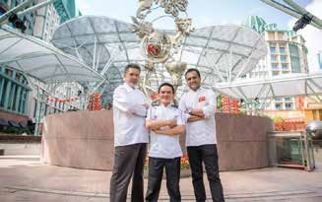
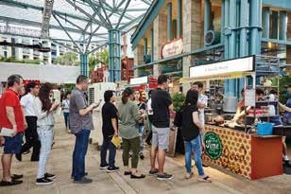
PSFF X THE MICHELIN GUIDE
Objectives
•
To boost the tourism sector of Penang to remain
competitive in the global travel market
To increase visibility of the festival in the international media world
To showcase Penang’s iconic culinary landscape imbued with rich history and traditions
To build Penang as the 9th city in the Asia Paciﬁc
region which is listed on the MICHELIN Guide
To promote Penang as a food haven, locally and internationally
•
•
•
•
Penang Street Food Festival Proposal 2019

Slide 26

PSFF X THE MICHELIN GUIDE
How it Works?
•
Look for esteemed MICHELIN star chefs in the Asia
Paciﬁc region who are interested to be part of Penang
MICHELIN Street Food Festival
Three (3) to ﬁve (5) MICHELIN star chefs will be
shortlisted within three (3) months
Shortlisted MICHELIN star chefs will be given some
time to prepare a brand new recipe which incorporates local favourites into the dish
Their authentic creations will be sold on the spot
•
•
•
Penang Street Food Festival Proposal 2019

Slide 27
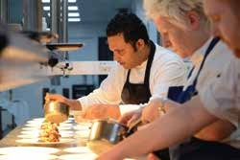
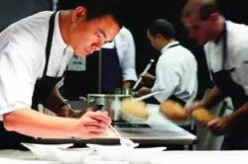
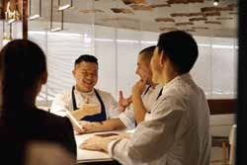

PSFF X THE MICHELIN GUIDE
Other Programme Highlights
�
-
-
Cooking Demonstration
Michelin star chefs display their cooking prowess They slice, dice and chop their way to deliver the best rendition of their high quality dishes
�
-
‘Unfold the Stars’ Sharing Session
Get to know the stories of these successful and prominent elites in the culinary industry
They will share some insightful experiences and thoughts throughout the years
-
Penang Street Food Festival Proposal 2019

Slide 28







PSFF X THE MICHELIN GUIDE
The Michelin Guide Street Food Festival
in Other Countries
•
•
•
Singapore
Macau
Hong Kong
•
•
•
Shanghai
Korea
Japan
Penang Street Food Festival Proposal 2019

Slide 29
PSFF X THE MICHELIN
GUIDE
Michelin / Bib Gourmand
Chef Appearance Fees
(USD 10, 000 x 5 Chefs)
USD 50, 000
Accomandation
& Transportation
USD
8, 000
Cooking Equipment
& Materials
USD
2, 000
Administration Fee
to Michelin Group
USD 10, 000
Total
USD 70, 000
Penang Street Food Festival Proposal 2019

Slide 30
BUDGET
Main Set Up & Equipment:
- Main Stage & Backdrop
- Sound System, Lighting & Wiring
- Generator Set, DB Box & Power Point
- Canopy, Tables & Chairs
RM 80,000
Decoration:
- Entrance Arch
- Photo Booth
- Backdrop & Signage
- Information Counter
- Stall Decoration
- Street Lighting
RM 80,000
Publicity:
- Street Bunting
- Poster & Leaflet
- Facebook Advertisement
RM 30,000
Documentation:
- Copy writer
- Videographer & Photographer
RM 10,000
Production:
- Graphic Designer
- Event Coordinator & manager
- Event Crew & Event Host/Emcee
- Cleaner, Rela & First Aid
RM 20,000
Other:
- Transportation
- Licensing
- Insurance
- Program & Stage Event
RM 30,000
PSFF X The Michelin Guide Street Food Festival:
- Administration Fee for The Michelin Guide
- Chef Allowance
- Transportation & Accommodation
RM280,000
Administration
RM 50,000
Total
RM580,000
Penang Street Food Festival Proposal 2019

