Slide 1
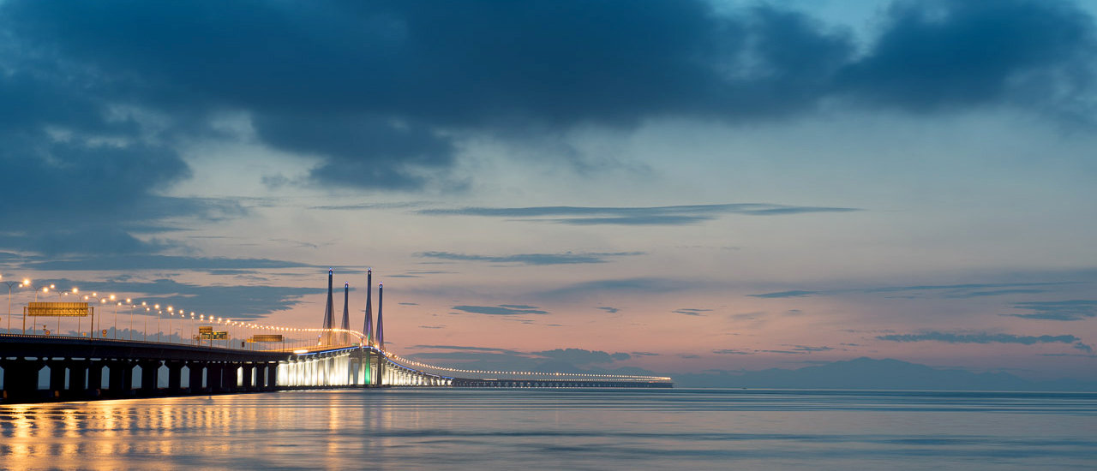







Return Ticket to Penang by AirAsia
- 3D2N Shangri la Rasa Sayang
-Pacific world Airport Transfer + Full day tour
-Penang Experience pass ×2
-BE @ Penang ×2
Grand Prize

Slide 2




Grand Prize
-Return Ticket to Penang by AirAsia
-Northam Junior Suites 3D2N
-Tour Incentive Airport Transfer + Half day tour
-Penang Experience pass 1

Slide 3


Grand Prize
-Return Ticket to Penang by AirAsia
ParkRoyal 3D2N
Tour Incentive Airport Transfer + Half day tour
Penang Experience pass 1

Slide 4


Grand Prize
Return Ticket to Penang by AirAsia
Lexis Hotel 3D2N
Mypassion Half day tour
Penang Experience pass 1

Slide 5

Prize
Holiday Inn 3D2N
Mypassion half day tour

Slide 6


Prize
Royale Chulan Penang 3D2N
Habitat 2

Slide 7

Prize
Clan Georgetown 2D1N
Habitat 2

Slide 8

Prize
Lone Pine Hotel 2D1N
Habitat 2

Slide 9


Prize
The Prestige 2D1N
Penang Hoho 2

Slide 10


Prize
Hampton By The Beach 2D1N
Penang Hoho 2

Slide 11
Prize
Hampton By The Beach 2D1N
Penang Hoho 2

Slide 12

Prize
Iconic Hotel 2D1N
Penang Hoho 2

Slide 13
Prize
BE Pass 1
Penang Hoho 2

Slide 14
Prize
BE Pass 1
Habitat 2

Slide 15
Prize
BE Pass 1
Habitat 2

