Slide 1


Date | 16 – 18 October 2019
Venue | Sands expo convention centre B2, Singapore
Penang Pavilion | Booth C O5 / Hall F
Co-exhibitors | The Habitat Penang Hill, The Northam All Suite Penang, Tour & Incentive Travel, Lone Pine Hotel, Shangri La Rasa Sayang, Holiday Inn Resort, Pacific World Destination, Royale Chulan Penang, The Prestige Hotel, Discovery Overland Holidays, Iconic Hotel, Penang Convention & Exhibition Bureau

Slide 2
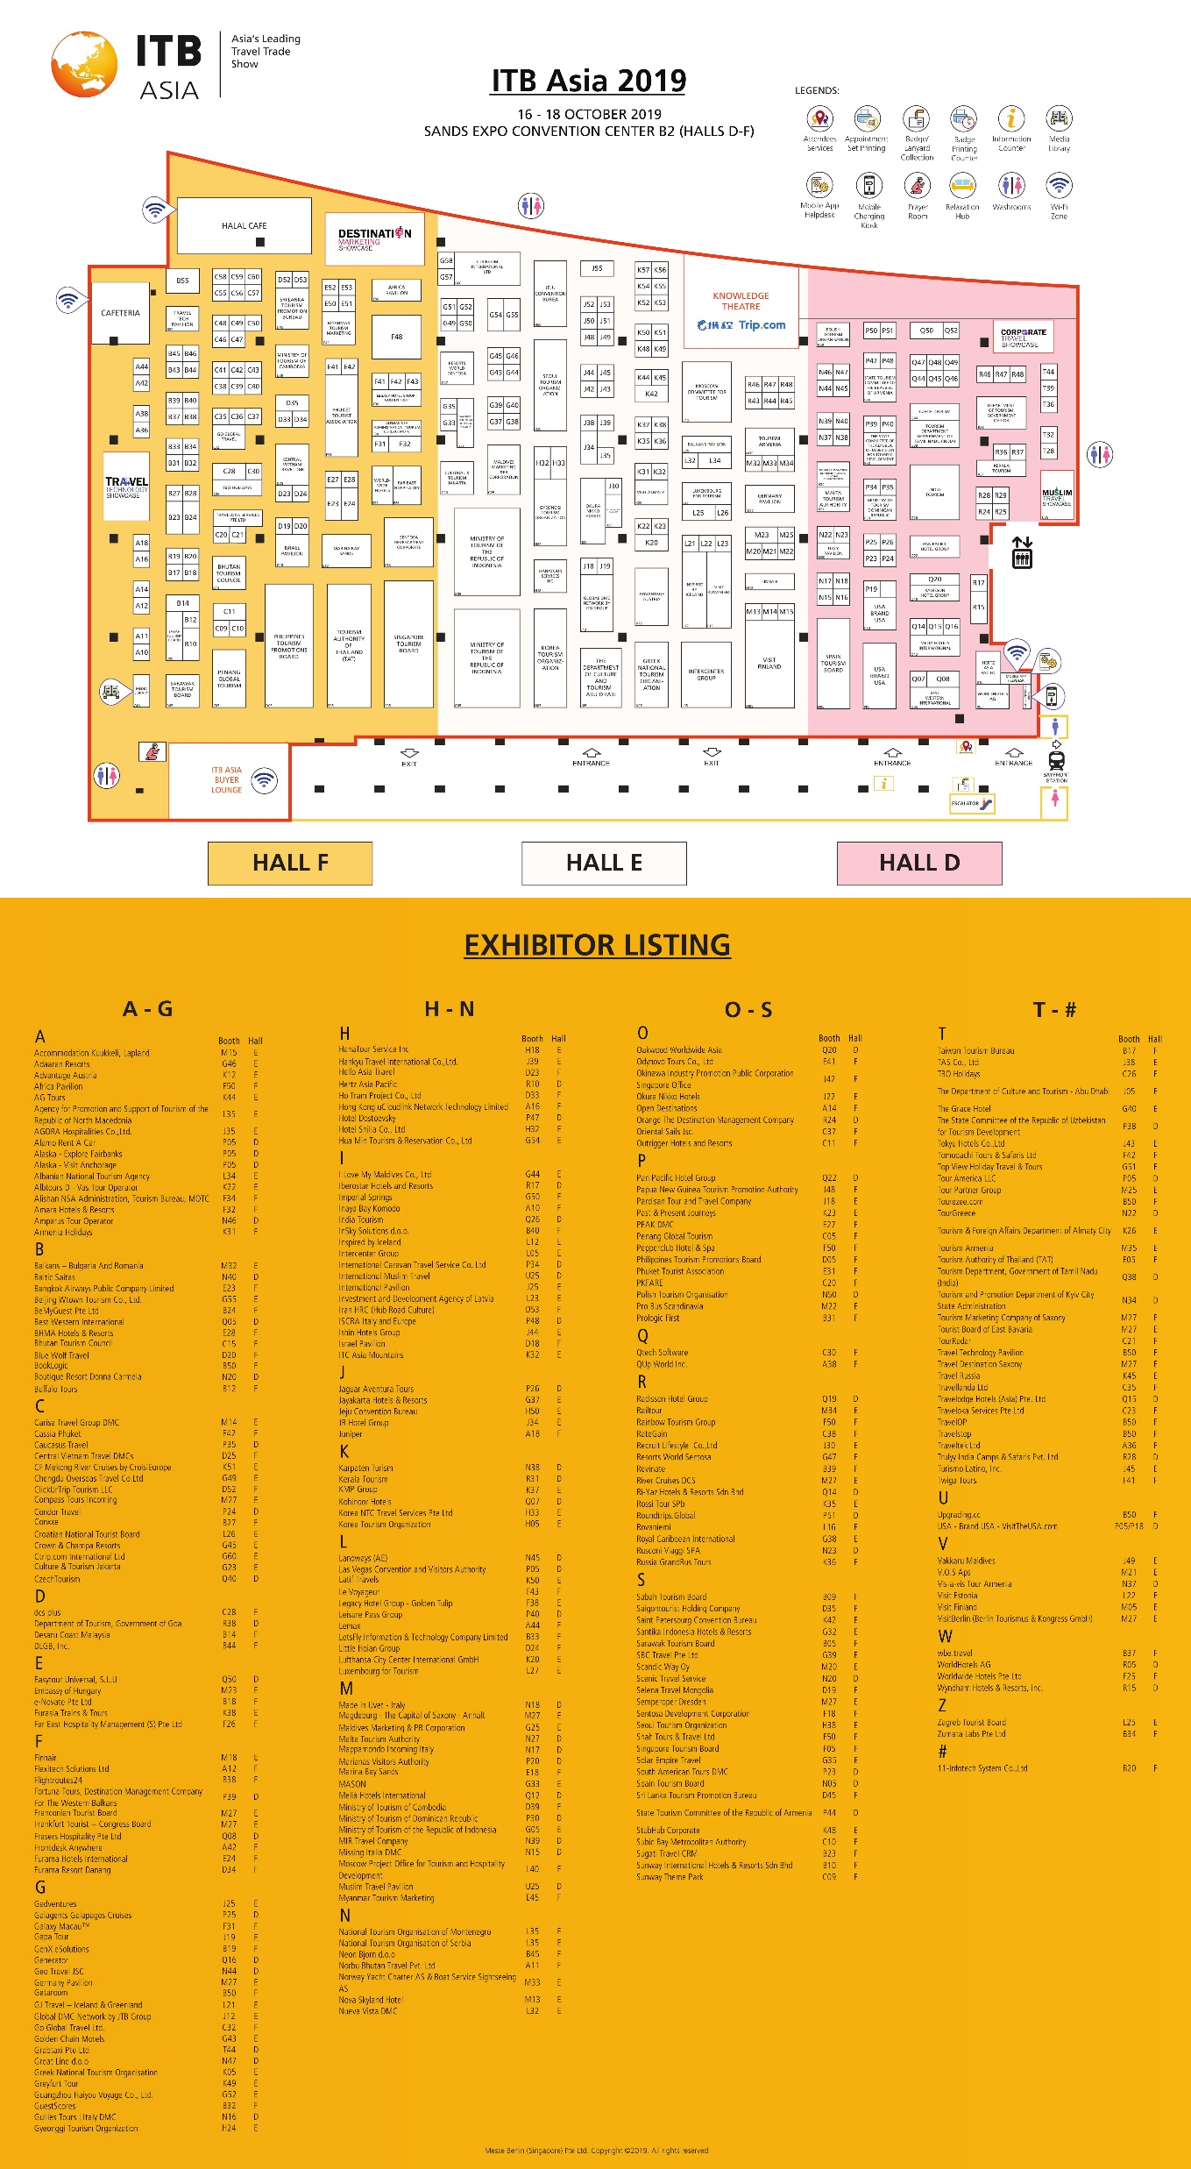


Slide 3
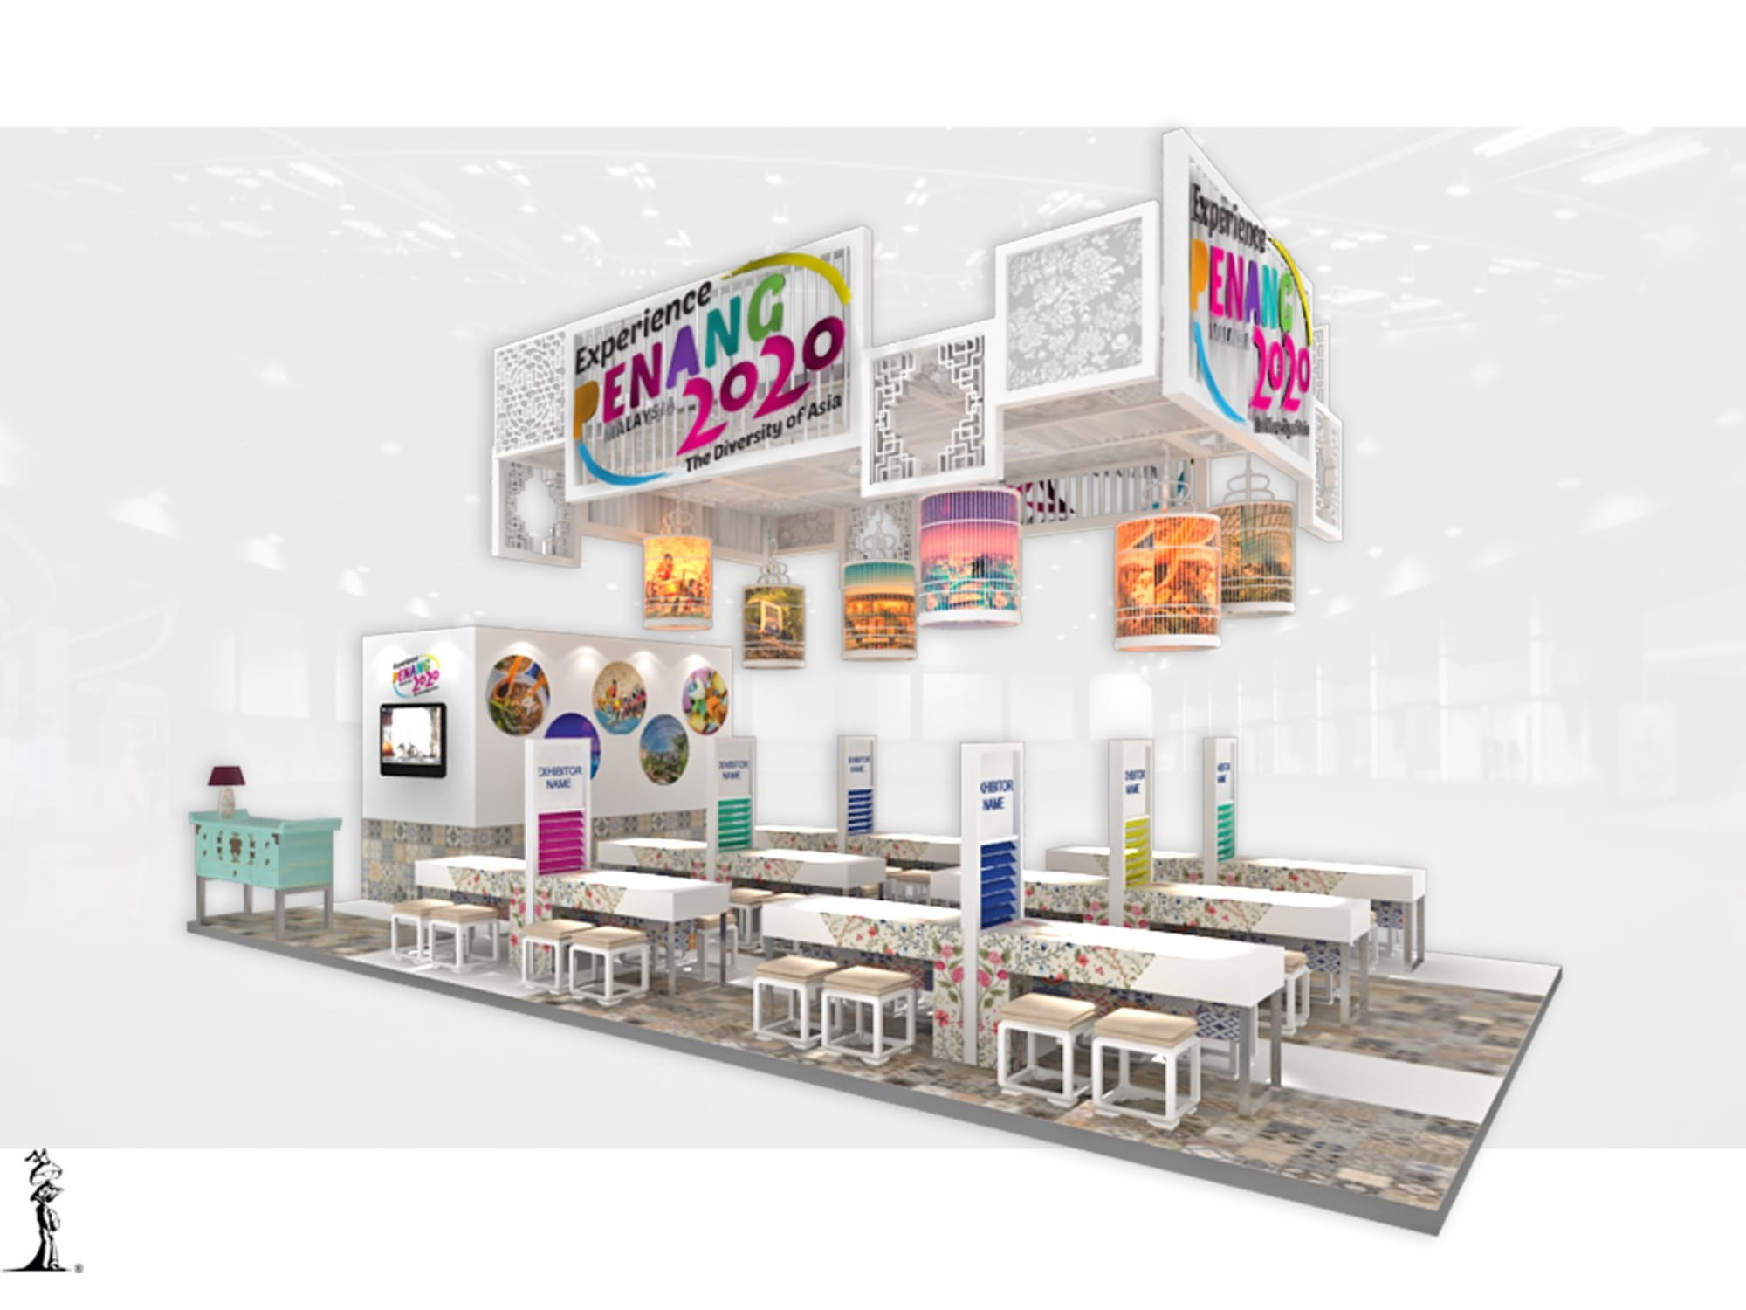
Booth Design

Slide 4
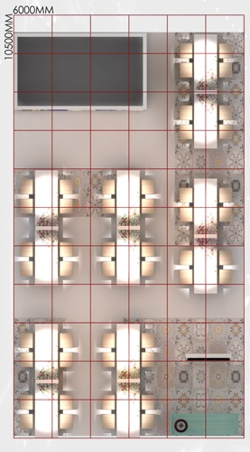
12
Co-exhibitor Seating Allocation.
The Habitat Penang Hill
The Northam All Suite Hotel
Tour & Incentive Travel
Lone Pine Hotel
Shangri-La’s Rasa Sayang Resort & Spa
Holiday Inn Resort
Royale Chulan Penang
Pacific World Destination
The Prestige Hotel
Discovery Overland Holidays
Iconic Hotel
Penang Convention & Exhibition Bureau
11
4
8
10
3
7
9
2
6
1
5

Slide 5
PGT CONTACT DETAILS (DURING ITB ASIA SINGAPORE)
OOI CHOK YAN
CEO
chokyan@penanglobaltourism.com
YOON PAULINE
Assistant Manager
pauline@penanglobaltourism.com
+60164735119
MALATHi
Tourism Executive
malathi@penangglobaltourism.com
+60165132793

Slide 6
Options to obtain your badges

Slide 7
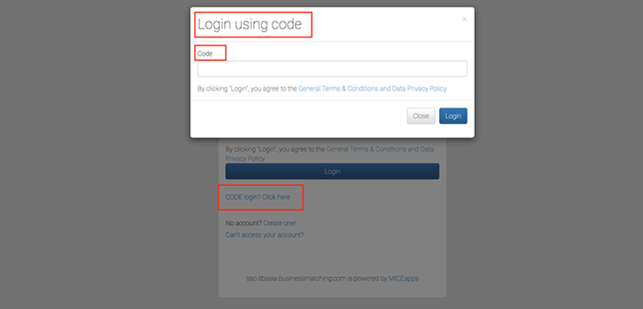
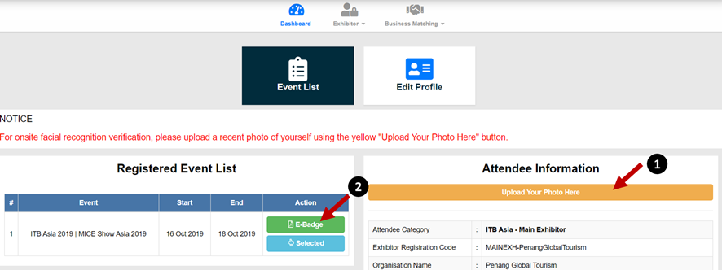
1. Online
To beat the queue, it is best to upload their photo online via their respective account
Go to https://itbasia-businessmatching.com and login with Login Code
Upload photo (headshot only, no group photo) and note that each badge is only tagged to 1 photo
Once uploaded, click on green “E-Badge” button to download badge
Collect badge holder and lanyard on site

Slide 8
2. Onsite
Proceed to registration counter at Level 1, Hall A
Get the photo taken and print badges on the spot

