Slide 1
Options to obtain your badges

Slide 2
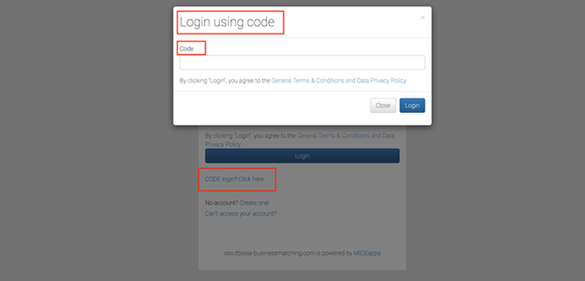
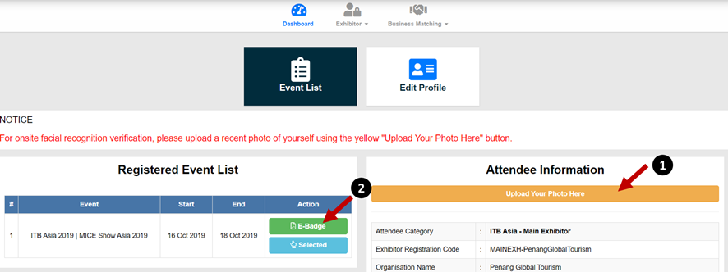
1. Online
To beat the queue, it is best to upload their photo online via their respective account
Go to https://itbasia-businessmatching.com and login with Login Code
Upload photo (headshot only, no group photo) and note that each badge is only tagged to 1 photo
Once uploaded, click on green “E-Badge” button to download badge
Collect badge holder and lanyard on site

Slide 3
2. Onsite
Proceed to registration counter at Level 1, Hall A
Get the photo taken and print badges on the spot

